Slide 1



Why and How to Measure
Food Loss and Waste
Brian Lipinski March 28, 2019
Notes:
Hello everyone – I’d like to thank you for all for being here. My name is Brian Lipinski from the World Resources Institute, and I’m here to share with you the outcome of a yearlong project which has produced two important pieces of work that I think will really help North America and the world at large tackle its problem with food loss and waste. So I’m going to share some of the key aspects of that work with you today.

Slide 2
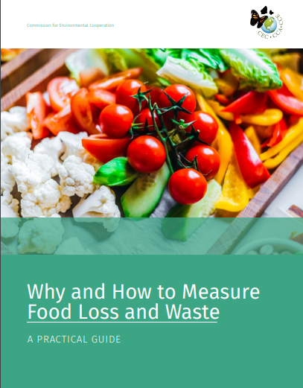
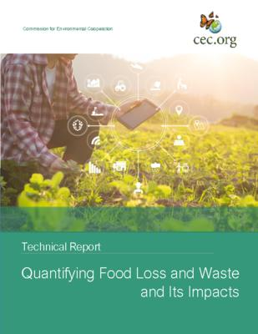
Download at: www.cec.org/Measurement
Notes:
Throughout the course of 2018, with the generous support of the Commission for Environmental Cooperation, we convened an expert group focused on the question of food loss and waste measurement. Specifically, we wanted to develop a set of resources for businesses and governments in North America who were interested in measuring their food loss and waste toward the goal of food loss and waste prevention and reduction. Through this project, we have developed two resources that will assist in the measurement process.
The first, which you see before you, is titled simply “Why and How to Measure Food Loss and Waste: A Practical Guide.” It contains a series of steps that will walk a new user through the process of food loss and waste measurement, which I’ll walk us through during this presentation. The other document is a longer Technical Report, which provides a deeper amount of detail and research for those who might want to dig a bit deeper. The report discusses the methods for quantifying FLW and surplus across the supply chain and the approaches for estimating environmental, financial and social impacts caused by FLW and food surplus. It includes detailed information that supports the practical guide, allowing the latter to be a more user-friendly document. Together, the two documents are designed to help governments, the food industry, business, institutions and nonprofit organizations better understand FLW and surplus measurement at each stage of the food supply chain within North America.

Slide 3
Expert Group
Jean Buzby (USDA)
Cristina Cortinas (Independent Consultant)
Lesly Gonzalez Montaño (Nestle)
Martin Gooch (Center for Food Chain Excellence)
Monica McBride (World Wildlife Fund)
Cher Mereweather (Provision Coalition)
Pete Pearson (World Wildlife Fund)
Gustavo Pérez Berlanga (Toks Restaurants)
Renan Alberto Poveda (World Bank)
Andrew Rhodes (Pronatura Mexico, A.C.)
Bruce Taylor (Enviro-Stewards Inc.)
Ashley Zanolli (Specialist)
Notes:
The guide is broken up into seven modules, which walk the user through the steps necessary to understand why measuring food loss and waste (or FLW for short) is beneficial for them, and then how to go about doing it. The guide is fully interactive and not intended to be a cover-to-cover read – instead, in the digital version it’s completely interactive and allows the user to jump to whatever interests them the most.
So for our purposes today, I’d like to go through each of these sections for you quickly so that you understand just how useful and beneficial this resource can be.

Slide 4
Seven Modules for Food Loss and Waste Measurement
Why Measure FLW?
The Business Case for FLW Reduction
Managing Change
Setting Your Scope
Determining Root Causes
Selecting KPIs and Identifying Impacts
Sector-Specific Guidance
Notes:
The guide is broken up into seven modules, which walk the user through the steps necessary to understand why measuring food loss and waste (or FLW for short) is beneficial for them, and then how to go about doing it. The guide is fully interactive and not intended to be a cover-to-cover read – instead, in the digital version it’s completely interactive and allows the user to jump to whatever interests them the most.
So for our purposes today, I’d like to go through each of these sections for you quickly so that you understand just how useful and beneficial this resource can be.

Slide 5
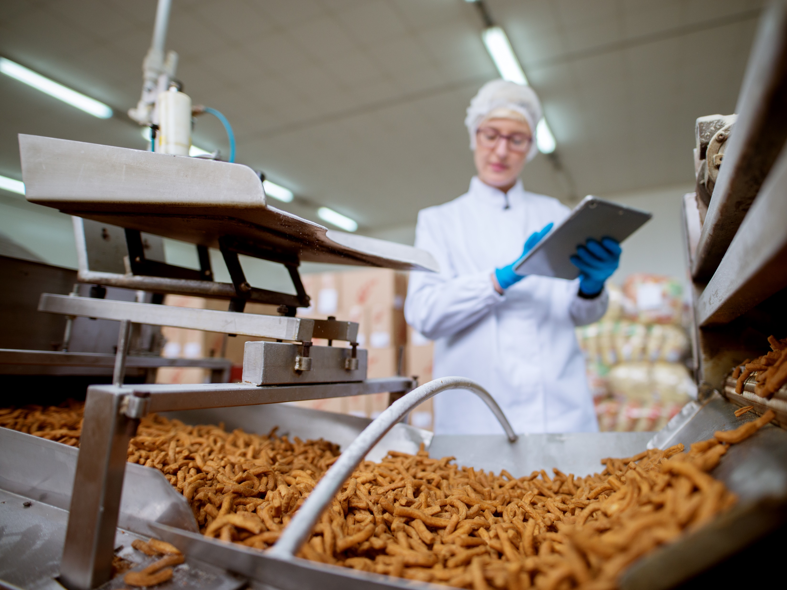
Why Measure FLW?
Economic:
Wasted food = wasted money
Also wasted opportunities for new products
Social
Huge amounts of food go to waste despite malnourishment and undernutrition
396 kg/capita in Canada, 249 kg/capita in Mexico and 415 kg/capita in the United States
Environmental
When food is wasted, so are all the environmental inputs: land, water, fertilizer, fuel and more
Reducing FLW reduces your environmental footprint
Notes:
Why Measure FLW? A significant amount of food grown for human consumption is never eaten. In fact, by weight, about one-third of all food produced in the world in 2009 was lost or wasted (FAO 2011). In North America, approximately 168 million tonnes of FLW are generated annually.
Therefore, this level of inefficiency suggests three strong incentives to reduce food loss and waste: economic, environmental and social.
Economically: wasted food equals wasted money. The huge amounts of food lost or wasted are currently considered part of the cost of doing business as usual. Rather than trying to maximize the value of food produced, companies and other organizations tend to focus on the disposal costs for the products that are lost or wasted. Companies could make significant economic gains by putting food headed for the waste stream to profitable uses.
Socially: Hunger is still a problem for each of the North American countries, and yet, significant amounts of food still get lost or wasted. Surplus edible food can be redistributed to food banks, food rescue agencies and other charities, which can direct it to food insecure populations, making good use of the food rather than disposing of it.
Environmentally: When food is lost or wasted, all of the environmental inputs used on that food are wasted as well (FAO 2011). That means all the land, water, fertilizer, fuel and other resources that produced, processed, or transported a food item are wasted when food meant to be consumed by people is thrown away. Food waste sent to landfills creates methane—a powerful greenhouse gas. Thus, reducing FLW can reduce a company’s environmental footprint.

Slide 6
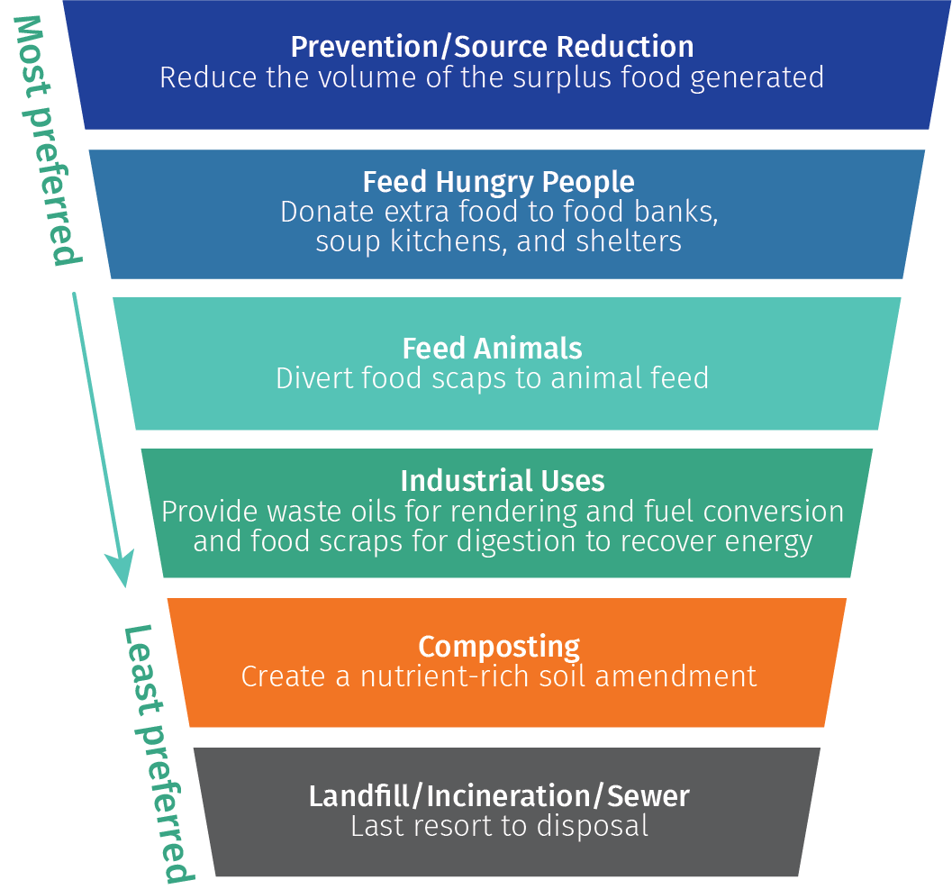
The Food Recovery Hierarchy
Notes:
What you see here, is what we call The Food Recovery Hierarchy. And what it shows is that when trying to reduce FLW, the first emphasis should be on prevention, or source reduction. Although some end-of-life destinations for FLW have fewer negative impacts than others (for example, FLW going to animal feed is preferable to FLW going to a landfill), prevention should be the foremost goal. This principle is reflected in the Food Recovery Hierarchy, originally developed by the United States Environmental Protection Agency (US EPA).
Source reduction (i.e., preventing food waste in the first place) is the most desirable way to address FLW because it prevents the negative social, environmental and economic impacts of producing food that is wasted.

Slide 7
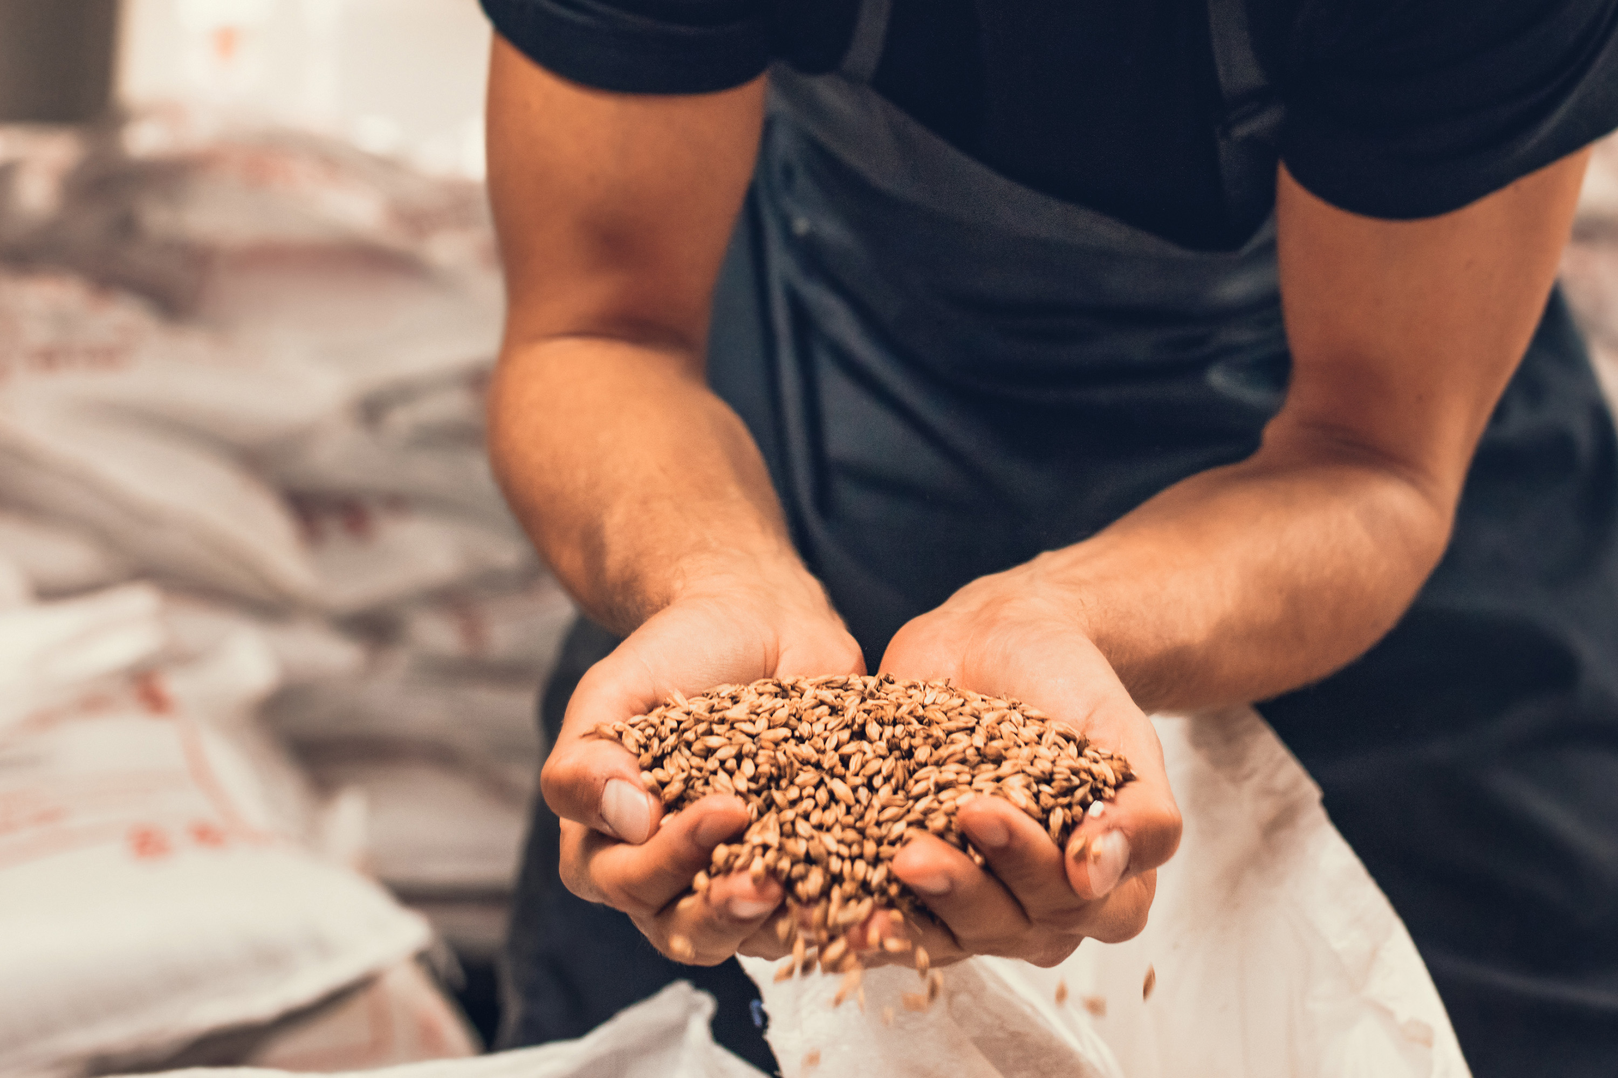
The Business Case
Start with measurement
Determine how much food loss and waste you have, and what it is costing you
Don’t just look at disposal fees
Take action
Determine the potential costs and benefits of steps to prevent and reduce FLW
Payback periods for FLW prevention are often less than one year
Notes:
Once you know WHY you want to measure FLW, you’ll need to determine your business case for doing so. This starts with measurement – you need to know how much food loss and waste are costing you at the moment, and what the opportunity is for preventing that. Measurement also allows you to determine what kinds of food are being lost or wasted at what stage of the food supply chain, so that you know where to target action. A common mistake, though, in this stage is to only consider the cost of disposing the food, when in fact you should be considering the value of the food as well. For example, imagine a manufacturer that makes tomato paste. This manufacturer sends a tonne of tomato waste to the landfill each month at a cost of $100. However, that same amount of tomatoes are valued at $900 at the time they are removed from the food supply chain. So in actuality, the cost of the FLW is the $900 in lost product value in addition to the $100 in disposal fees, resulting in a total loss of $1,000 each month.
Once you have a measurement, you can take action. You’ll have the information necessary to tailor your food loss and waste prevention and reduction to the interventions that will be most beneficial to you. And payback periods for these steps can be quick – often less than a year.

Slide 8

Managing Change
FLW measurement isn’t just about numbers or economics, it’s about people
Need to be ready to respond to resistance:
“We don’t waste any food.”
“We have too much else going on.”
“It’s not worth the cost.”
“This is the way we’ve always done things.”
“This isn’t working.”
Notes:
You can have the best economic assessment in the world, though, and it doesn’t necessarily guarantee success. Measuring and reducing food loss and waste is a big adjustment for many businesses, governments and other organizations. Achieving significant reductions means challenging key assumptions about how a system operates. To accomplish significant change, you must prepare for it.
.
Within an organization, individuals will find many reasons to resist taking action on FLW. These concerns are often legitimate and should not be disregarded. However, they generally fall into broad categories, like the following: “We don’t waste any food.” “We have too much else going on.” “It’s not worth the cost.” “This is the way we’ve always done things.” “This isn’t working.” The guide offers advice on how to approach each of these common and understandable concerns.

Slide 9
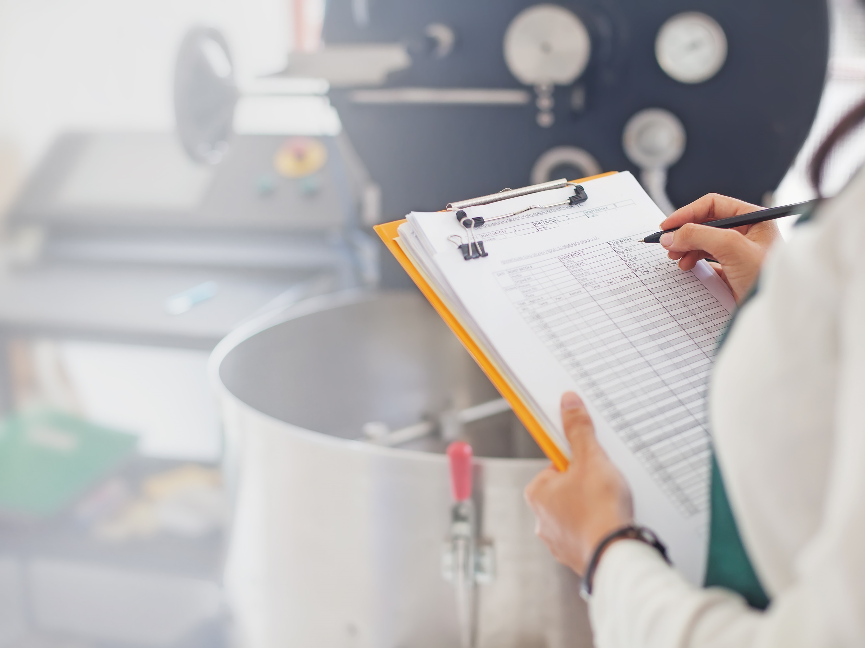
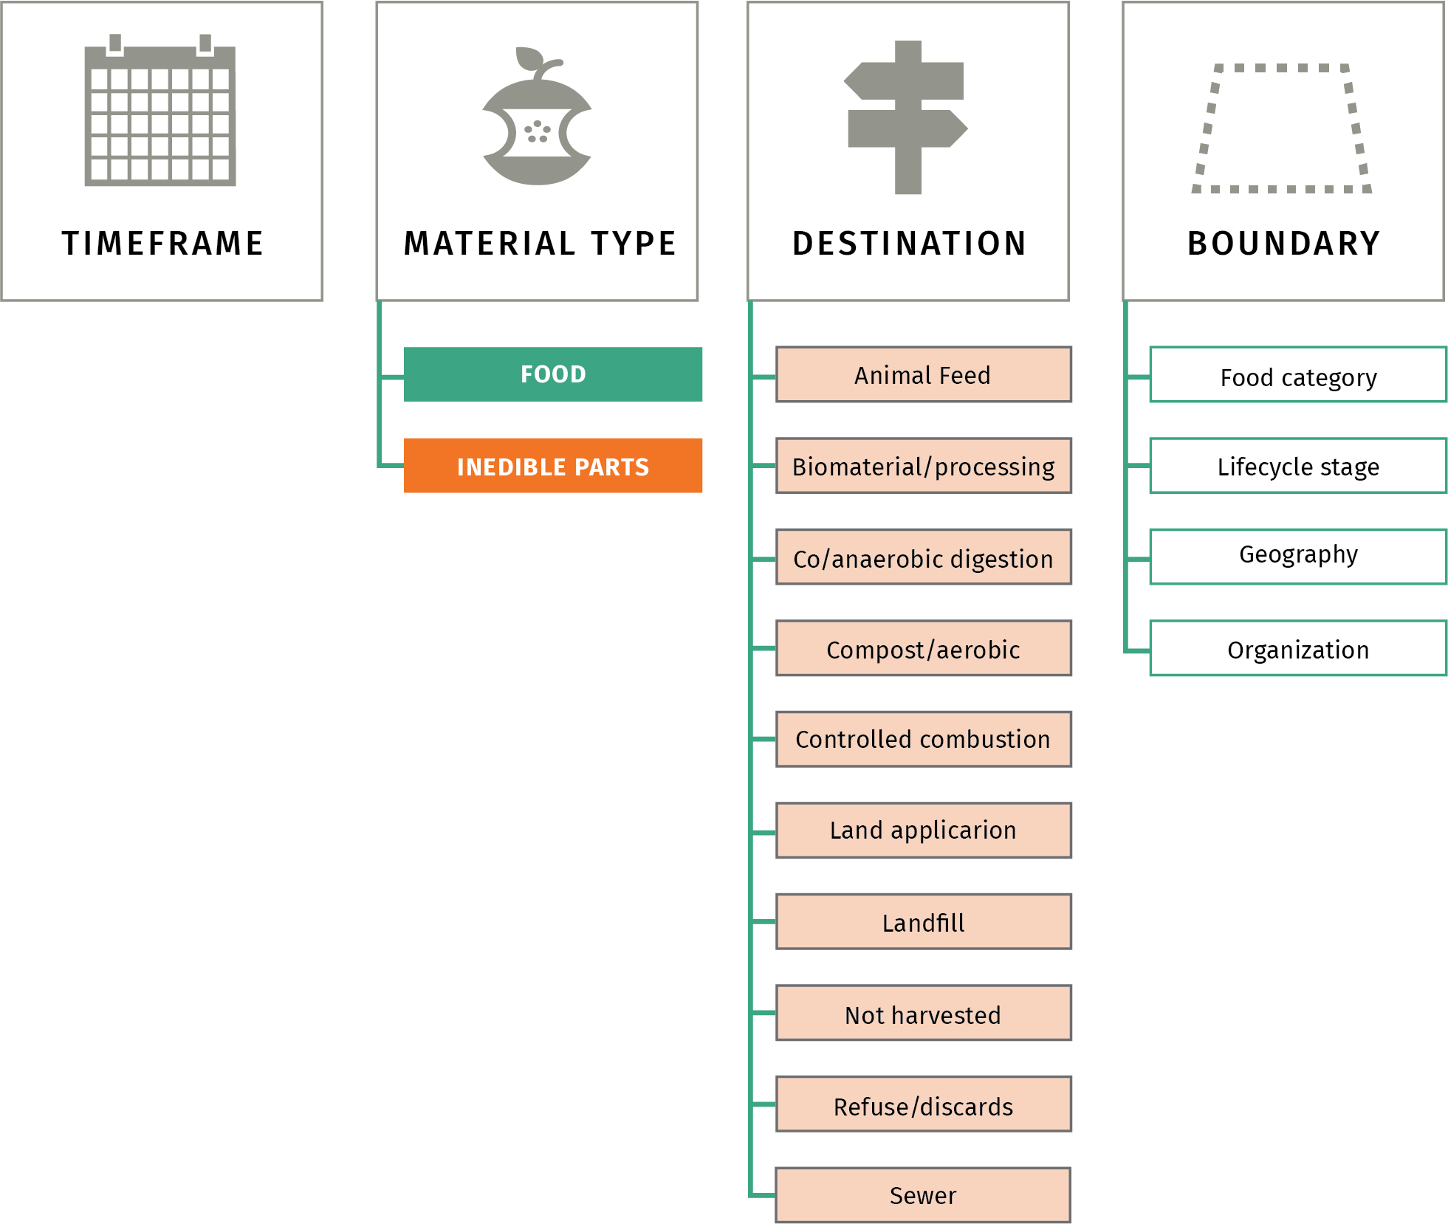
Setting Your Scope
Notes:
Once you’ve determined that it is worthwhile to measure FLW, define what FLW means in your operations and how you will communicate that information, both internally and externally. Reporting FLW data publicly has multiple benefits: it raises awareness of the issue, allows for information-sharing among businesses, provides information to policymakers and assists FLW tracking efforts over time.
I won’t get into too much technical detail here, but the guide uses the international Food Loss and Waste Accounting and Reporting Standard as a guide, which says that you should define food loss and waste by saying :
the timeframe in which it was measured,
whether you’re including just food or inedible parts like bones and rinds,
The destinations included, whether you’re just considering landfill as being waste, or if you’re including other places like sewer, animal feed, or anaerobic digestion, for example,
And then the boundaries – what types of food, what stage of the supply chain, the location you’re in, and what the organization being measured is, like a processing plant or a restaurant.
Although technical, these guidelines help to make sure everyone is talking about food loss and waste the same way, and allows for consistency over time.

Slide 10

Determining Root Causes
Learn not just what is being lost or wasted, but why
For example:
Imagine a restaurant that conducts measurements, and learns it is wasting a large amount of tomatoes each week due to spoilage
Spoilage is the cause of the FLW, but why did the tomatoes spoil to begin with?
Perhaps they order too many to begin with, or have poor refrigeration systems
Learning the causes of FLW allows you to tailor action to address those causes
Notes:
It is difficult to reduce FLW without understanding what causes it. You need to determine not just what or how much FLW is occurring, but why it is occurring. For example, after performing a waste composition analysis, a restaurant may discover that it is discarding a large amount of tomatoes each week due to spoilage, but that data doesn’t say why the spoilage is occurring. That restaurant will need to investigate further. Maybe it’s due to over-ordering, or due to poor refrigeration? Once the owners of the restaurant know what that root cause is, they can take action to reduce that waste. This module of the guide describes how to track causes of FLW when the information is not obvious in the quantification method.

Slide 11
Selecting Key Performance Indicators and Identifying Impacts
Economic/Financial
Costs of food
Costs of labor
Cost of FLW as a percent of food sales
Social
Amount donated
Nutritional content
Meals wasted
Environmental
Greenhouse gas emissions
Water
Land
Fertilizer
Energy
Biodiversity
Notes:
Measuring FLW should go beyond simply measuring the amount of food that leaves the food supply chain. This measurement fails to capture the impacts and benefits of reducing and preventing FLW. Preventing FLW has far-reaching economic, environmental and social benefits that can also be tracked.
The guide describes these in three categories: economic/financial, social, and environmental, and provides information and tools on how to use these indicators.
The items included are:
Economic/Financial
Costs of food
Costs of labor
Cost of FLW as a percent of food sales
Social
Amount donated
Nutritional content
Meals wasted
Environmental
Greenhouse gas emissions
Water
Land
Fertilizer
Energy
Biodiversity

Slide 12
Sector-Specific Guidance
The guide gives suggestons on how to measure FLW for each of the following sectors:
Primary production
Processing and manufacturing
Distribution
Retail
Food service/institutions
Households
Whole Supply Chain Approaches
Notes:
Finally, the guide provides guidance for different sectors of the food supply chain on how to actually measure food loss and waste. Each section contains a short description of the sector and guidance on how to select the most appropriate measurement method for it, as well as a case study of how a company in that sector measured (or could measure) FLW.

Slide 13
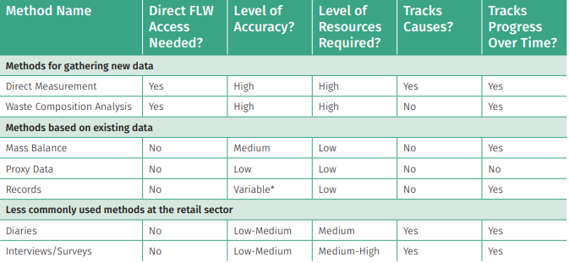
Retail
*Accuracy depends on the type of record used: for example, waste transfer receipts may be highly accurate for determining FLW levels, whereas other records are less accurate
Notes:
(NOTE TO PRESENTER: it is recommended that you only use 1-2 of these sectoral slides depending on the audience of interest and adapt the text on the “Primary Production” slide to be relevant to the sector or sectors you are presenting. Going through each sector would be repetitive and bore the audience. Instead, place the other sectoral slides in an Annex after the final slide and reference those tables if asked during a Q&A period.)

Slide 14
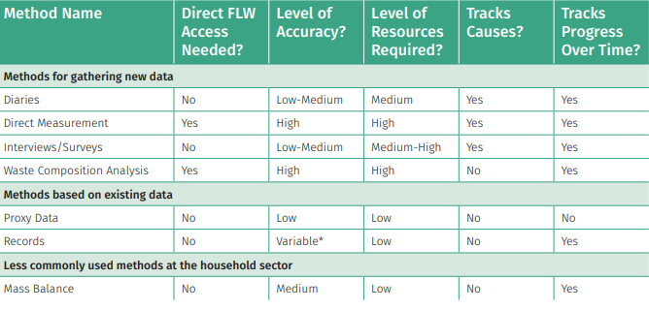
Household
*Accuracy depends on the type of record used: for example, waste transfer receipts may be highly accurate for determining FLW levels, whereas other records are less accurate
Notes:
(NOTE TO PRESENTER: it is recommended that you only use 1-2 of these sectoral slides depending on the audience of interest and adapt the text on the “Primary Production” slide to be relevant to the sector or sectors you are presenting. Going through each sector would be repetitive and bore the audience. Instead, place the other sectoral slides in an Annex after the final slide and reference those tables if asked during a Q&A period.)

Slide 15
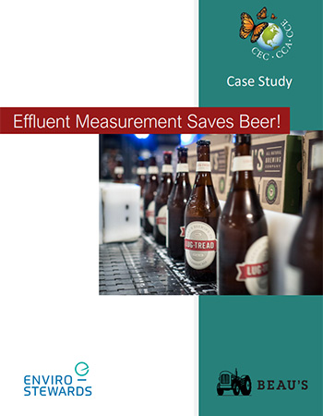
Case Study: Beau’s Brewery
Beau’s is Canada’s largest craft brewery
Applied the methods contained in the Practical Guide, including direct measurement, interviews, proxy data, records, and mass balance
Some key facts:
Beer Saved: 395,000 liters per year
Money Saved: C$722,000 per year
Average Payback: 0.8 years
Embedded GHG: 590 tonnes per year
Equivalent Meals: 165,000 per year
Notes:
We also have some excellent case studies showing the usefulness of this guide. The first is from Beau’s Brewery, Canada’s largest craft brewery. In 2018, Beau’s partnered with the Commission for Environmental Cooperation and Enviro-Stewards to undertake a Food Loss Prevention Case Study focused on food loss to the drain. Enviro-Stewards carried out an assessment of the brewery’s loss and waste using the guide, using a mix of methods including direct measurement, interviews, proxy data, records, and mass balance equations. From this assessment they identified three food loss prevention opportunities that would allow Beau’s to increase production, save money and reduce embedded emissions. By implementing these measures, Beau’s could increase product yield by 7.4 percent, with a payback of less than one year and savings of C$722,000 per year. Implementing these measures would also significantly reduce organic waste haulage, reduce loadings entering the effluent treatment system, reduce embedded greenhouse gas (GHG) emissions by 590 tonnes per year, and preserve food calories equivalent to 165,000 meals per year.
The three prevention opportunities were: 1. Recovery of additional wort from brew kettles following each batch; 2. Recovery of additional beer from fermenter yeast; and 3. Reducing product loss during kegging.

Slide 16

Case Study: Toks
Toks is a Mexican restaurant chain with over 200 locations
Applied the methods contained in the Practical Guide, including direct measurement, waste composition analysis, interviews, and records
Some key facts
Recoverable food: 17.9 tons/yr
Savings: 330,000 pesos/yr
GHG emissions avoided: 40 tons/yr
Equivalent meals: 31,006/yr
Notes:
The second case study is from Toks, a Mexican restaurant chain with over 200 locations. In 2018, in one location Toks carried out a sample measurement exercise and discovered that total FLW generated in the establishment in one year represents the equivalent of 31,006 meals, equal in weight to 17.9 tons per year handled as waste. Additionally, around 27% of the waste generated in the pre-consumer process is made up of food.
By conducting a measurement exercise comprised of a number of methods found in the practical guide, Toks identified three areas of solutions, based on the FLW hierarchy:
Prevention/Source reduction: a) sensitizing personnel to better use inputs or raw materials; b) implementing measures enabling the reuse of some foods in the branch's operations; c) preparing smaller quantities of food; d) modifying or substituting some of the food containers used; e) informing the customer and offering FLW reduction options.
Feed hungry people: organizing excess food donation activities through different means, such as food banks.
Feed animals: a) acquiring the necessary equipment to storage food at the branch, ensuring its adequate conservation and subsequent valorization; b) executing agreements with service providers interested in using this food.
They found that their return on investment should pay for itself within 0.6 years, and would allow them to donate 3,8 tons of food per year. So as you can see, by working with the practical guide, the company is able to benefit financially, there are societal benefits through additional donated food, and their environmental impact is reduced.

Slide 17
Download at: www.cec.org/Measurement
Notes:
That’s a summary of the guide, but I invite you to dig in yourself and discover the additional detail contained within. The guide can be downloaded from www.cec.org/measurement in Spanish, English and French. I’ll be happy to take any additional questions during the Q&A period, and thank you again.

Slide 18
Questions?
Download: www.cec.org/Measurement
Notes:
That’s a summary of the guide, but I invite you to dig in yourself and discover the additional detail contained within. The guide can be downloaded from www.cec.org/measurement in Spanish, English and French. I’ll be happy to take any additional questions during the Q&A period, and thank you again.

