Slide 1
TWO PART WEBINAR
Part 1. Quantifying Food Loss and Waste - Guidance and Methods
Part 2. Open Question & Answer
February 21, 2018
By Kai Robertson
Lead Advisor, FLW Protocol, World Resources Institute
Notes:
30 minutes on Part 1 - In the first half hour of this webinar, we’ll guide you through how to describe the scope of your FLW inventory using the language in the FLW Standard, including reviewing an interpretation of which material types and destinations count for Sustainable Development Goal Target 12.3.
30 Minutes on part 2 – Open question / answer (on ANYTHING related to FLW S not just methods)

Slide 2
Part 1.
Quantifying Food Loss and Waste - Guidance and Methods
Notes:
In the first half hour of this webinar, we’ll guide you through how to describe the scope of your FLW inventory using the language in the FLW Standard, including reviewing an interpretation of which material types and destinations count for Sustainable Development Goal Target 12.3.
Take a few minutes to get everyone on the same page with a few slides of context.

Slide 3
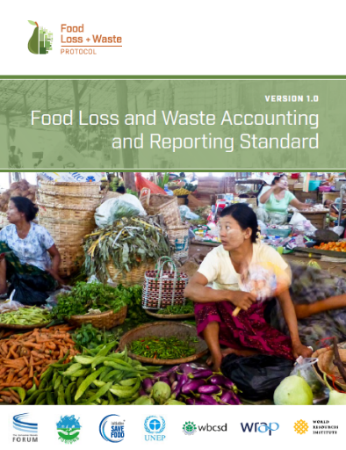
Value Gained By Using the FLW Standard
Common language
Reporting framework
Practical guidance
“… provides consistent language to use … and standard ways to measure and report.”
Kellogg Company
Notes:
Background about the FLW Standard for those of you new to it
It’s a framework for describing what has been quantified using a common language.
Provides a consistent framework for summarizing what you’re quantified (reporting framework) so you can tell if you’re comparing apples to apples. Enables companies, countries, cities and others to transparently describe what has been quantified
To help you use the standard and measure FLW, lots of practical guidance.
As you see by the quote from the Kellogg Company –
On last webinar (December 13th) went over the range of tools and resources on the FLWProtocol.org website for using the standard.

Slide 4
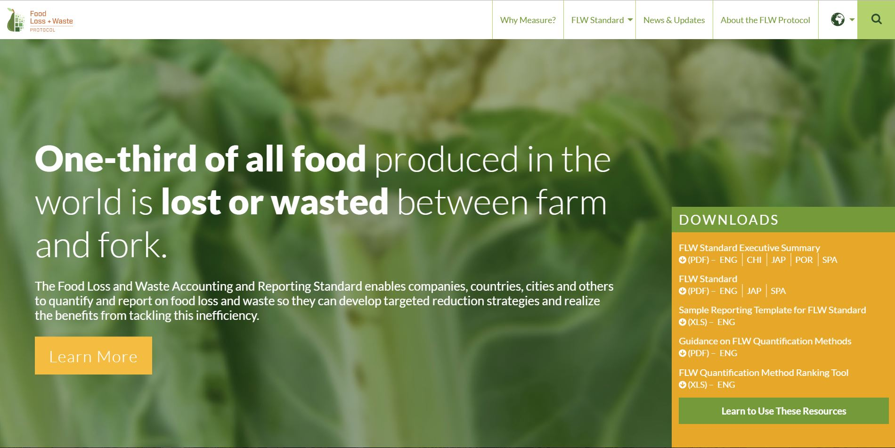
Home Page| www.FLWProtocol.org
Notes:
On FLWProtocol.org…
You can access all the resources along with the recording of the last webinar about the range of resources downloadable here
From the home page you can go directly to download the exec summary or standard – first two items in the orange box.
In both of these documents you’ll see – will see this set of steps

Slide 5
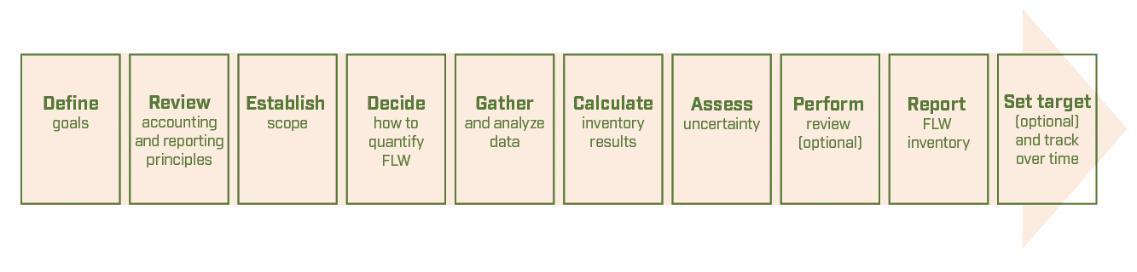
Steps to Quantify and Report on FLW
Why quantify?
What to quantify?
How to quantify?
Reporting
Focus of
the webinar
Notes:
These are the steps laid out in the FLW Standard for how one goes about developing a Food Loss and Waste inventory. Not always linear and TODAY will focus on the fourth, fifth and sixth steps (how to quatify)..
Reminder that:
Why drives What an entity decides to include as part of its scope.
Establish scope. When we refer to establishing scope, this is about determining and describing four key items that will be covered by the FLW inventory - the timeframe, material type(s), destination(s), and boundary. I will talk about each of these as we go through the webinar.
I’ll focus first on what we refer to in the FLW S as the material type and destination.

Slide 6

Visually Represent Your Scope Using the FLW Standard
(insert timeframe)
Food
Animal Feed
Food category = (insert text)
Pre-harvest losses and the weight of product packaging is excluded from the weight of FLW.
(modify and/or insert additional relevant text)
Inedible parts
Biomaterial/
processing
Lifecycle stage = (insert text)
Co/anaerobic digestion
Compost/aerobic
How to customize this template:
Indicate what material types and destinations are included as the scope.
Color in the box and add a check mark.
Geography = (insert text)
Controlled combustion
Land application
Organization = (insert text)
Landfill
Not harvested
Refuse/discards
Sewer
Notes:
Back to this visual. It’s a template that’s downloadable from the FLW Protocol
Related Issues -
Two of the scope items are material type and destinations Five components as see here. Discussed material types and destination.
Timeframe is for which the inventory results are being reported – with starting and ending date
Boundary (four dimensions of FLW inventory).
Food category: Types of food included in FLW being reported
[Optional: Entity to use Codex GFSA system (for more detailed information use GPC or UNSPSC)
Examples: all food, all fruits and vegetables, dairy, chicken]
Lifecycle stage: The stages in food supply chain or food lifecycle within which reported FLW occurs
[Optional: Entity to use UN ISIC classification system to identify points in food supply chain to identify if only direct operations are included or also other stages up- or downstream
Examples: Entire food supply chain, manufacturing, retail]
Geography: Geographic borders within which reported FLW occurs
[Optional: Entity to use UN region or country codes (and write in description for more narrow scope)
Examples: Globe, region, country, state/province, city/village]
Organization: Organizational unit for which amount of FLW is being reported
[Optional: Entity to write in description
Examples: entire company, three stores, 100 households, five farms
If FLW is reported for a geographic unit, such as a city or nation, then the “geography” and “organization” may be the same]

Slide 7
Guidance on “How”

Slide 8
About FLW Quantification Methods
The FLW Standard requires that an entity: “Describe the quantification method(s) used. If existing studies or data are used, identify the source and scope.”
The FLW Standard does not require use of a particular quantification method – an entity may select whichever method(s) best meets its particular needs and may also choose to use methods not described in the standard.
The stand-alone Guidance on FLW Quantification Methods document provides an overview of 10 methods commonly used to quantify FLW:
Direct weighing
Counting
Assessing volume
Waste composition analysis
Records
Diaries
Surveys
Mass balance
Modeling
Proxy data
Plus: Quantifying FLW if water is added (Appendix A)
Notes:
The quantification method(s) chosen will be influenced by multiple factors –
particular goals, scope selected, human and financial resources, direct access to the physical lost or wasted food.
I highlighted the five methods that seem to be most common among food manufacturers (since the audience is largely manufacturers on these webinars).

Slide 9

Basic Steps for Collecting Data
TIP: You don't need a super accurate number to get started
Identify the main streams of possible FLW
  Where FLW is already separated from other material streams
    e.g., FLW to animal feed, compost, anaerobic digestion, or land application
  Where estimates may be needed to separate the FLW from other material streams
    e.g., fraction of total material to landfill and combustion that is FLW
Gather and assess existing data
Sources may include: storage records, waste collection receipts, scanner/shrink data, inputs/outputs of materials
Identify who has the data (e.g., store operations and corporate finance)
  Consider if existing data:
    fits your scope and is reliable, and
    could be extrapolated for other sites (if needed)
Where data does not exist, determine how to calculate the amount of FLW (i.e., measure, approximate, or infer by calculation)
Notes:
Some destinations may already be separated from other waste streams (e.g., FLW to animal feed, aerobic and anaerobic digestion, or land application)
Estimates may be needed to separate FLW from other waste (e.g., fraction of total waste to landfill and combustion that is FLW)

Slide 10
When Undertaking a New Calculation of FLW
Table 7.2 Issues that Affect an Entity’s Use of Different Types of Quantification
Issue | Considerations
Level of accuracy desired | In most situations, a measurement will result in a quantification of FLW that is more accurate than an estimate based on approximation; and both are typically (although not always) more accurate than FLW calculated by inference
Degree of access to the FLW | If an entity can get access to FLW it will be able to measure or approximate its weight; if not, it will have to use a method that is based on inferring the weight through a calculation
Resources available | Measuring and approximating data often require more staff time and budget (as well as access to the FLW) compared to inferring FLW through calculations
Practical aspects | For measurement or approximation to be feasible, an entity needs to consider a number of aspects such as the availability of power for electronic measurement devices; space for pre-sorting mixed wastes to separate out the FLW; and how FLW might be moved, stored, and sampled
Goals of quantification extend beyond the amount of FLW (e.g., understanding causes of FLW) | Methods based on inference by calculation typically do not offer the ability to expand beyond quantifying the amount of FLW but methods based on social-science research practices (e.g., diaries, surveys) are well suited to gathering additional information
See Chapter 7 of FLW Standard for additional details

Slide 11
Definition of Methods for Quantifying FLW
Measurement or Approximation | Methods | Definition
An entity can use the first four methods if it can get direct access to the FLW | 1. Direct weighing | Using a measuring device to determine the weight of FLW
 | 2. Counting | Assessing the number of items that make up FLW and using the result to determine the weight; includes using scanner data and “visual scales”ª
 | 3. Assessing volume | Assessing the physical space occupied by FLW and using the result to determine the weight
 | 4. Waste composition analysis | Physically separating FLW from other material in order to determine its weight and composition
 | 5. Records | Using individual pieces of data that have been written down or saved, and that are often routinely collected for reasons other than quantifying FLW (e.g., waste transfer receipts or warehouse record books)
 | 6. Diaries | Maintaining a daily record or log of FLW and other information
 | 7. Surveys | Gathering data on FLW quantities or other information (e.g., attitudes, beliefs, self-reported behaviors) from a large number of individuals or entities through a set of structured questions
Inference by Calculation | Methods | Definition
 | 8. Mass balance | Measuring inputs (e.g., ingredients at a factory site, grain going into a silo) and outputs (e.g., products made, grain shipped to market) alongside changes in levels of stock and changes to the weight of food during processing
 | 9. Modeling | Using a mathematical approach based on the interaction of multiple factors that influence the generation of FLW
 | 10. Proxy data | Using FLW data that are outside the scope of an entity’s FLW inventory (e.g., older data, FLW data from another country or company) to infer quantities of FLW within the scope of the entity’s inventory
ª Visual scales are practical pictorial aids used in agricultural contexts, typically to help assess the different levels of damage by pests to stored crops
* Methods noted in bold are common among food manufacturers
Notes:
The quantification method(s) chosen will be influenced by multiple factors –
particular goals, scope selected, human and financial resources, direct access to the physical lost or wasted food.
I highlighted the five methods that seem to be most common among food manufacturers (since the audience is largely manufacturers on these webinars).

Slide 12
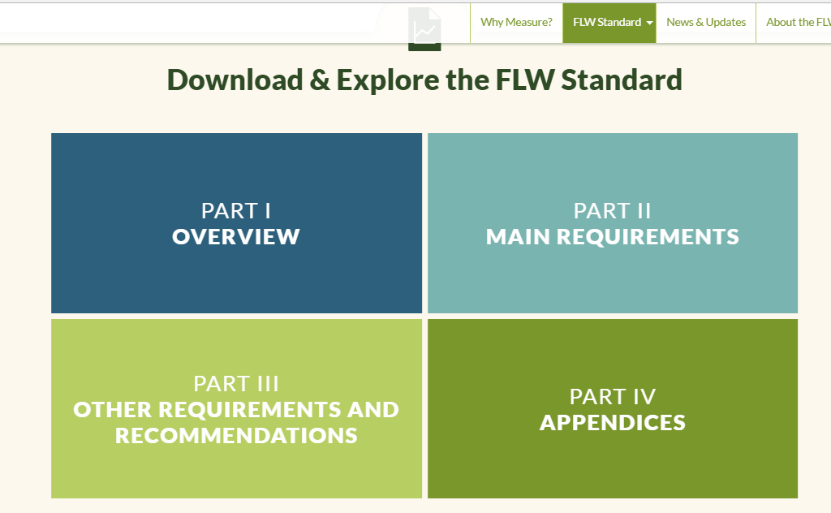
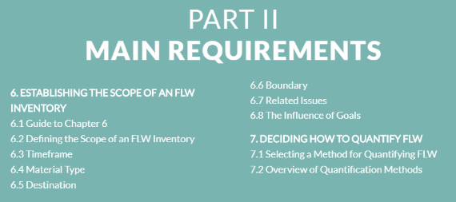
Where to Find Guidance on Methods in the FLW Standard
TIP: Hover over each box to see the table of contents; clicking on the Section of interest will take you right to that part of the FLW Standard
Notes:
Where find more details about the scope --- From what – to how

Slide 13
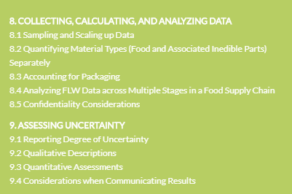
Where to Find Guidance on Methods in the FLW Standard
TIP: Hover over each box to see the table of contents; clicking on the Section of interest will take you right to that part of the FLW Standard
Notes:
Where find more details about the scope --- From what – to how

Slide 14
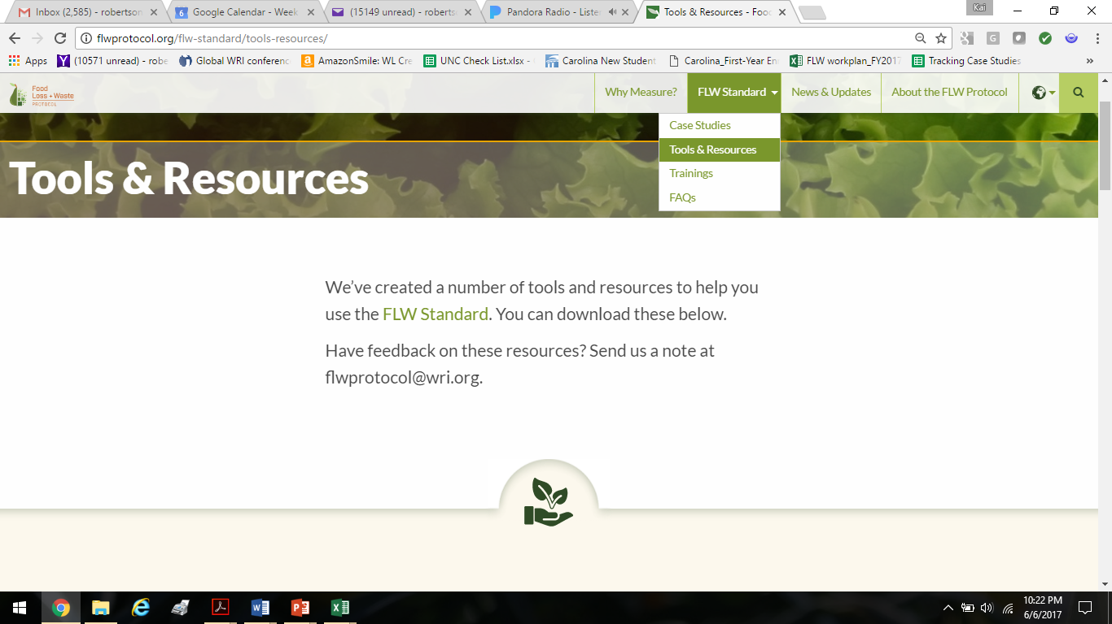
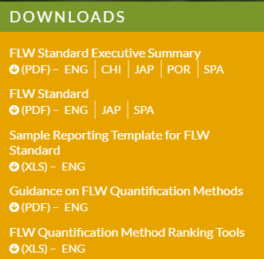
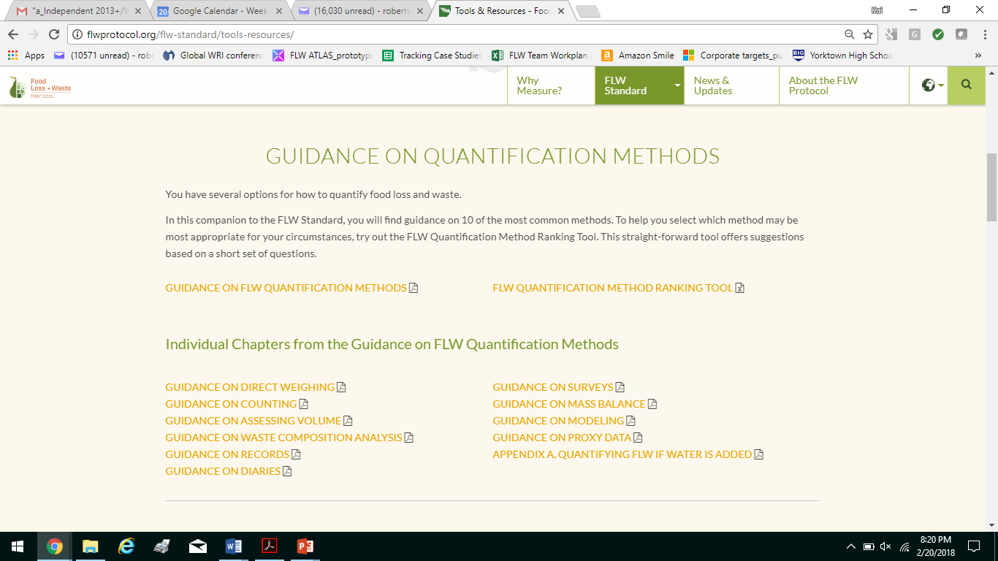
Where to Find the Guidance on FLW Quantification Methods (@ www.FLWProtocol.org)
From the home page
Individual chapter for each quantification method provides:
Overview
Advantages and disadvantages
Level of expertise required
Cost
Guidance on implementing the method
Notes:
The quantification method(s) chosen will be influenced by multiple factors –
particular goals, scope selected, human and financial resources, direct access to the physical lost or wasted food.
I highlighted the five methods that seem to be most common among food manufacturers (since the audience is largely manufacturers on these webinars).

Slide 15
FLW Standard Accounting and Reporting Requirements
Base FLW accounting and reporting on the principles of relevance, completeness, consistency, transparency, and accuracy
Account for and report the physical amount of FLW expressed as weight
3. Define and report on the scope of the FLW inventory Timeframe c. Destination Material type d. Boundary
4. Describe the quantification method(s) used. If existing studies or data are used, identify the source and scope
Require-ments related to methods
5. If sampling and scaling of data are undertaken, describe the approach and calculation used, as well as the period of time over which sample data are collected
6. Provide a qualitative description and/or quantitative assessment of the uncertainty around FLW inventory results
7. If assurance of the FLW inventory is undertaken (which may include peer review, verification, validation, quality assurance, quality control, and audit), create an assurance statement
8. If tracking the amount of FLW and/or setting an FLW reduction target, select a base year, identify the scope of the target, and recalculate the base year FLW inventory when necessary
Notes:
Set up as a Word document; The three (in grey text) apply only under certain circumstances (#5, 7, and 8)

Slide 16
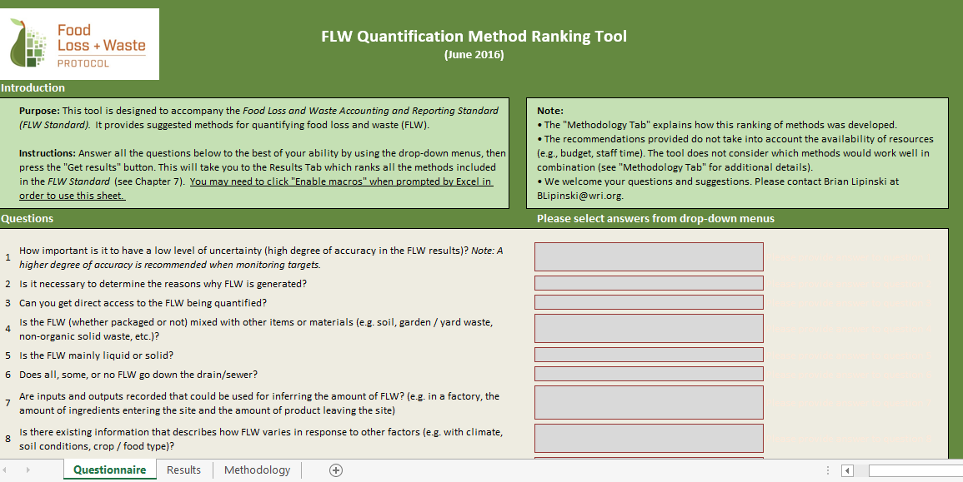
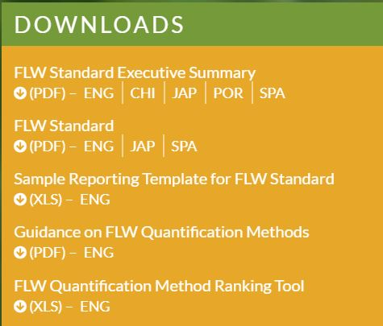
Tool to Assess Quantification Methods @ FLWProtocol.org

Slide 17
Questions in the Method Ranking Tool
1. How important is it to have a low level of uncertainty (high degree of accuracy in the FLW results)? Note: A higher degree of accuracy is recommended when monitoring targets.
2. Is it necessary to determine the reasons why FLW is generated?
3. Can you get direct access to the FLW being quantified?
4. Is the FLW (whether packaged or not) mixed with other items or materials (e.g. soil, garden / yard waste, non-organic solid waste, etc.)?
5. Is the FLW mainly liquid or solid?
6. Does all, some, or no FLW go down the drain/sewer?
7. Are inputs and outputs recorded that could be used for inferring the amount of FLW? (e.g. in a factory, the amount of ingredients entering the site and the amount of product leaving the site)
8. Is there existing information that describes how FLW varies in response to other factors (e.g. with climate, soil conditions, crop / food type)?
9. Do you have existing records that could be used for quantifying FLW? (For this purpose, records are individual pieces of data that have been written down or saved often for reasons other than quantifying FLW, e.g., waste transfer receipts or warehouse record books.)
10. Do you have access to those records? (The response is automatically "not applicable" to this question if the answer is "no" or "don't know" to question 9.)
11. Is a material/significant amount of FLW in its packaging?

Slide 18
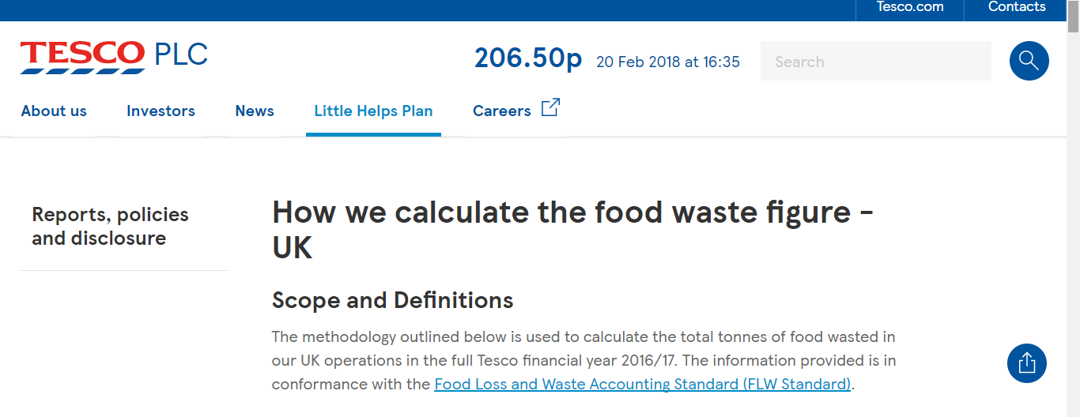
Example of a Food Retailer’s Reporting & Data Sources
Data Sources – existing retail and depot data sets
Retail and depot waste
Damaged, out-of-code, write-off, exceptional events waste
Product data (contents weight and the packaged weight per item)
Self-scan data
Bakery Weights data
Donation and charity data, range resets, stock clearance
Animal Feed tonnage
Published @ https://www.tescoplc.com/little-helps-plan/reports-policies-and-disclosure/how-we-calculate-the-food-waste-figure/
**
Notes:
Retail waste
DAM waste (products that are damaged in store, whether on the shop floor or in storage)
OOC waste (products that exceed the ‘Best before’ or ‘Use by’ date and can no longer be sold)
Product write off waste
Exceptional events waste
Depot waste
Product data (contents weight and the packaged weight per item)
Self-scan data
Bakery Weights data
Community Food Connection (CFC) Donations data
Other charity data
Range Reset data
Stock Clearance data
Animal Feed tonnage

Slide 19
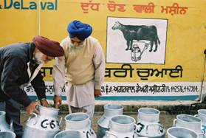
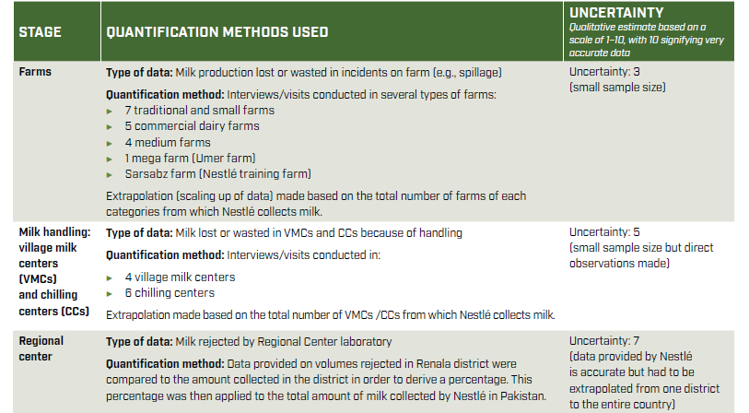
Sampling from Nestlé’s Dairy Supply Chain Study in Pakistan (Upstream Methods)
*Qualitative estimate based on a scale of 1–10, with 10 signifying very accurate data
Additional details provided in FLW Standard case study – available at: http://flwprotocol.org/case-studies/
Additional details published in the Journal of Cleaner Production. See case study titled “Measuring food waste in a dairy supply chain in Pakistan”- available at: <http://www.sciencedirect.com/science/article/pii/S0959652616321473>.

Slide 20

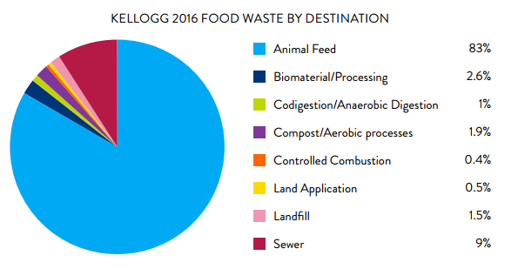
Methods Kellogg Company Used
FLW quantification methods include:
Direct weighing
Records
Waste composition analysis
Volume
Proxy data
Additional details provided in FLW Standard case study – available at: http://flwprotocol.org/case-studies/
**
Notes:
Their scope includes animal feed!!

Slide 21
Sampling of Kellogg Company’s Methods, Assumptions & Uncertainty
Destination | Quantification Methods Used | Uncertainty*
Animal feed | Material: Food Quantification method: Records from waste management vendors, primarily derived from direct weighing at the destination Assumptions: Assumes that minimal amounts of water are added for disposal as dry feed is much prefered by vendors over wet | 7 Minimal verification of vendor data
Co/anaerobic digestion | Material: Food and Sludge Quantification methods: Records from waste management vendors, primarily derived from direct weighing at the destination Assumptions from sludge waste composition analysis Assumptions: Assumes 15% of sludge weight represents food waste and the remaining 85% is water. Assumption based on average of 2015–2016 sludge analysis from one cereal manufacturing location in the UK. During anaerobic/aerobic digestion, some food is consumed, but bacteria also generate waste and die; this is assumed to be negligible. | 5 Minimal verification of vendor data Assumptions scaled up from limited waste composition analysis
*Qualitative estimate based on a scale of 1–10, with 10 signifying very accurate data
Additional details provided in FLW Standard case study – available at: http://flwprotocol.org/case-studies/

Slide 22
Sampling of Kellogg’s Methods, Assumptions & Uncertainty
Destination | Quantification Methods Used | Uncertainty *
Controlled combustion | Material: Food and Sludge Quantification method: Records from waste management vendors, primarily derived from direct weighing at the destination Assumptions from sludge and general waste composition analysis Assumptions: See sludge assumption above. Assumes that 25% of general waste sent to incineration is food waste. Assumption based on 2009 waste analysis from two manufacturing locations (covering both cereal and snack production) in the UK. | 5 Minimal verification of vendor data Assumptions scaled up from limited waste composition analysis
*Qualitative estimate based on a scale of 1–10, with 10 signifying very accurate data
Additional details provided in FLW Standard case study – available at: http://flwprotocol.org/case-studies/

Slide 23
Additional Tools for Accessing
Guidance on
“How to Quantify”

Slide 24
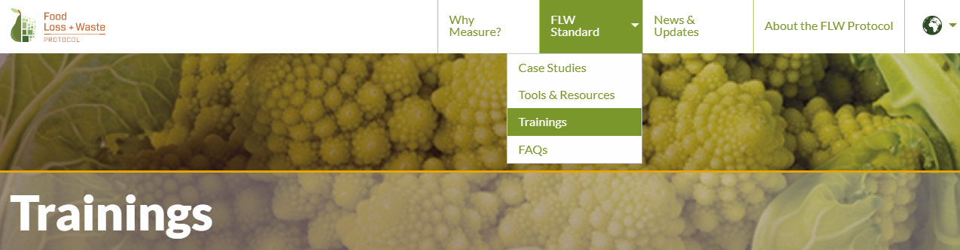
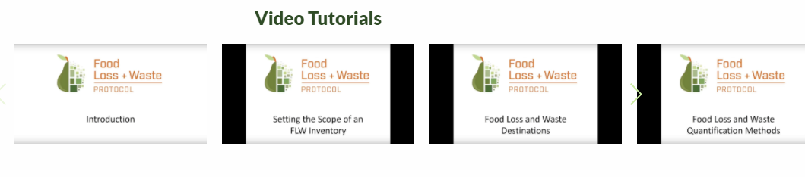
Video Review of 10 Quantification Methods
Notes:
Tutorial on how to describe scope

Slide 25
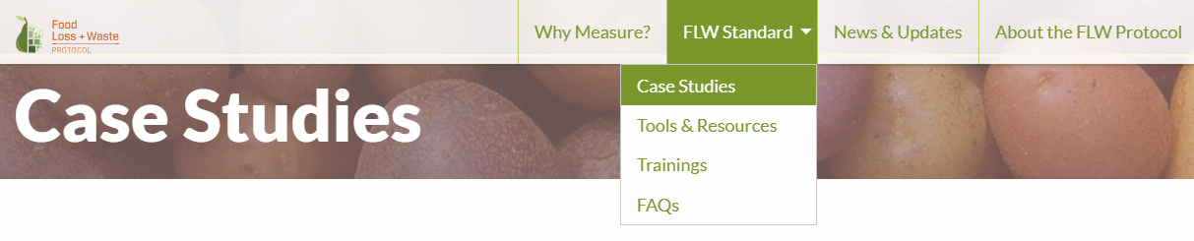
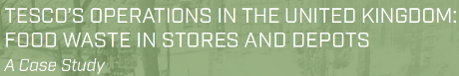
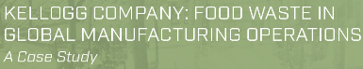
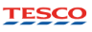
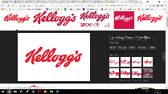
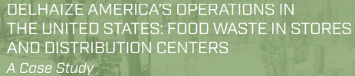
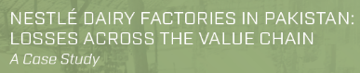
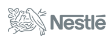
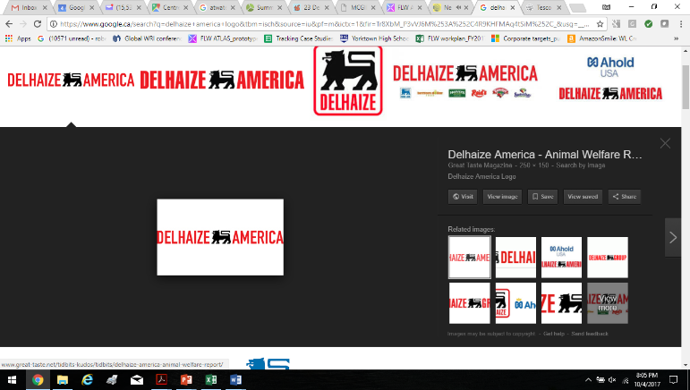
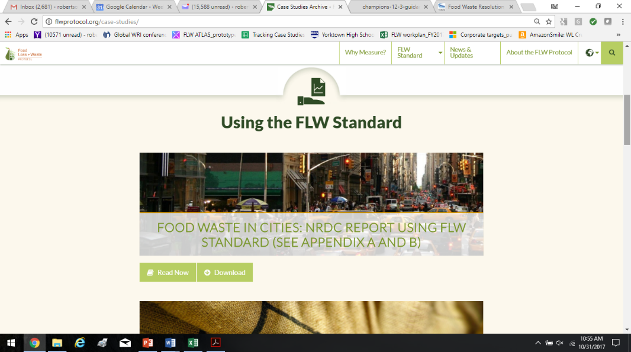
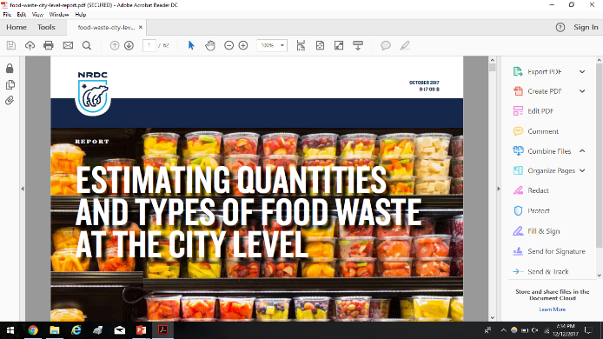
Examples of Quantification Methods in the Case Studies
        Benefits from using the FLW Standard
        Challenges faced and overcome in measuring
        How to summarize an FLW inventory using the FLW Standard
        Actions being taken to reduce FLW
More in the Pipeline:
Cranswick plc, Danone, Campbell’s, Sobey’s, Walmart
Notes:
In pdf and html – if of interest

Slide 26
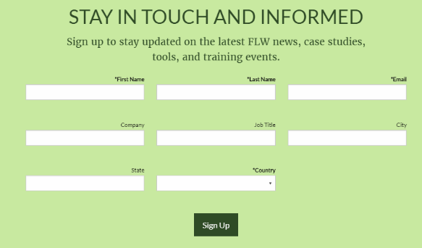
Next Steps
Sectoral guidance and other tools under development
Monthly webinar series to continue March 21st (third Wednesdays)
  Send us your thoughts on questions and topics to address
If you aren’t already signed up for the news update, do so at the bottom of any page @ FLWProtocol.org

Slide 27
Part 2.
Open Question & Answer

Slide 28


Slide 29






Acknowledgements | Funders of WRI’s FLW Initiative
The Netherlands Ministry of Economic Affairs
Note: The Ministry of Foreign Affairs of the Netherlands, the Royal Danish Ministry of Foreign Affairs, the Swedish International Development Cooperation Agency (SIDA) and the Department of Foreign Affairs and Trade of Ireland (Irish Aid) provided core funding of the World Resources Institute, which made possible the development of the Food Loss and Waste Protocol.

Slide 30
Contact Us With Questions
www.flwprotocol.org
For questions and suggestions, contact:
Kai Robertson (robertson.kai@gmail.com)
Brian Lipinski (blipinski@wri.org)
Craig Hanson (chanson@wri.org)

